Slide 1
Inventory management system
Presentation by Nicholas Overd

Slide 2
Introduction
My origins are in engineering so allow me to apply a logical thought process to code, of course since I have little experience in this field it means my code is not the best but the potential is there.

Slide 3
Specification
The specification is to:
Create a system where customers can make orders which contain items.
Give the customer the ability to look at all items orders or other customers
Have the customers order price given to them
Have the system automated through Jenkins and sonarqube

Slide 4
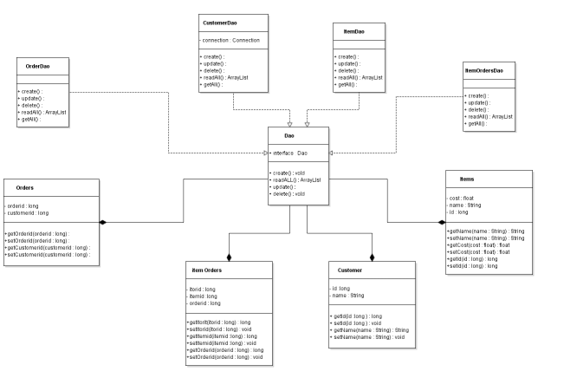
Analysis & design
Initial design though software like UML and EDR is necessary for the project to work.
Since being aware of issues makes you plan against them, this can prevent many issues in the future.
Analysis in terms of understanding the project:
Making a initial idea as to the code to create
Functionality.

Slide 5
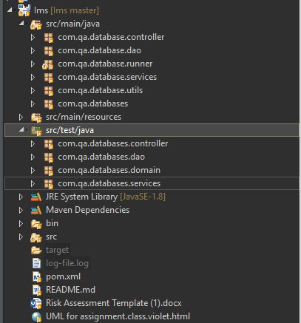
Coding
Main body of the project
Using Chris's organisation method I split the code into specific packages
For my services, ims/runners, controllers ect..
This allows readability of code meaning it is easier to
understand which is critical in coding as work is rarely a solo job.
These are some meathods used :
- Mock tests
OOP principles
SOLID principles
Mockito

Slide 6
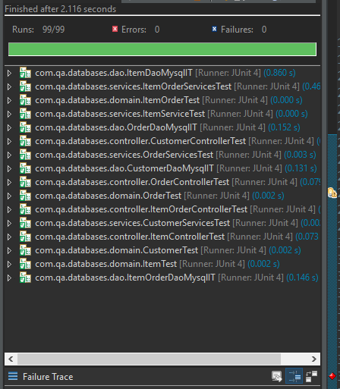
Testing
Testing is a key part of creating systems.
As it will reduce errors in the system or at least make you aware of them.
Errors will turn up eventually either from you from clients or from hackers, tests are a way to reduce risk.
In these tests I used mockito as a more efficient way of testing

Slide 7
Automation
Automation is key with coding since that is why coding was created.
Automation on this project used Jenkins to push your git repository to sonarqube for testing.

